Slide 1
STEM PROJECT 2019

Slide 2
Our Shared vision is in delivering a shared education partnership between the pupils, staff, governors, parents and community that delivers;
For our pupils:
Fun active and stimulating learning opportunities
Creation of sustained friendships
Equality for all

Slide 3
Our Shared vision is in delivering a shared education partnership between the pupils, staff, governors, parents and community that delivers;
For our staff:
Co-operative and collaborative opportunities
Time and space for effective professional reflection
Shared resources

Slide 4
Our Shared vision is in delivering a shared education partnership between the pupils, staff, governors, parents and community that delivers;
For our parents and community:
Opportunities for social cohesion within the wider community
Opportunities to support their child’s development

Slide 5
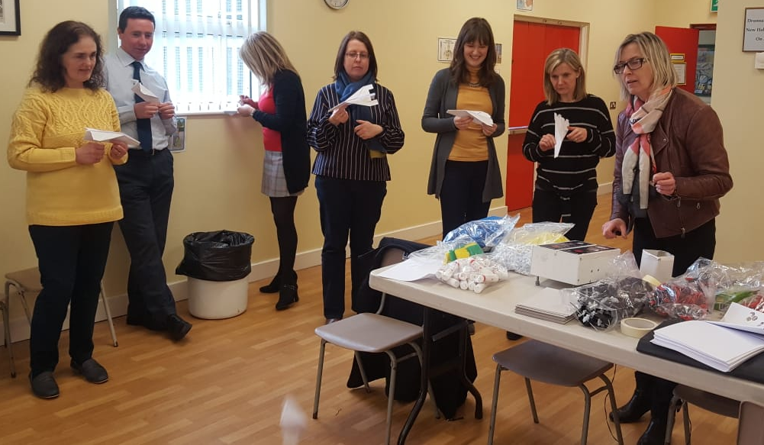
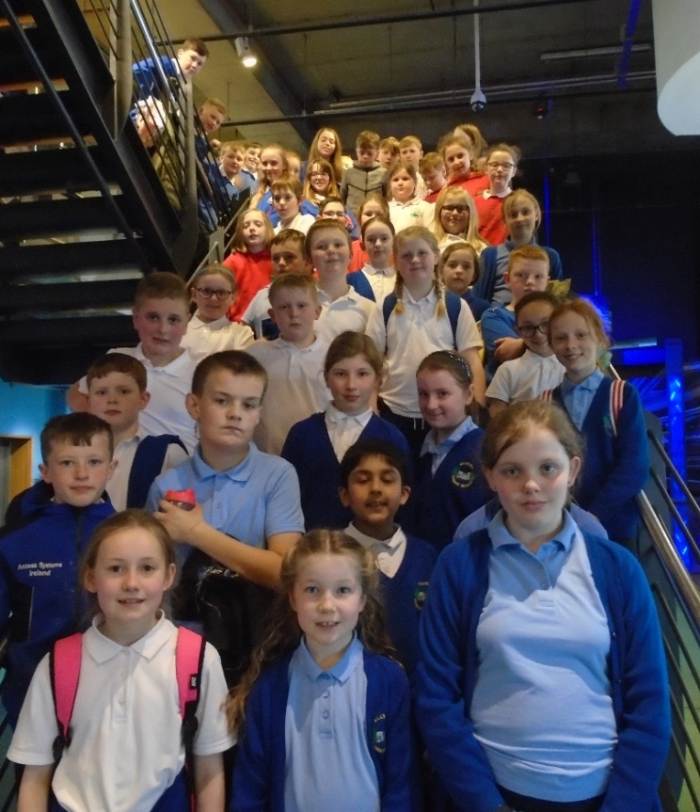
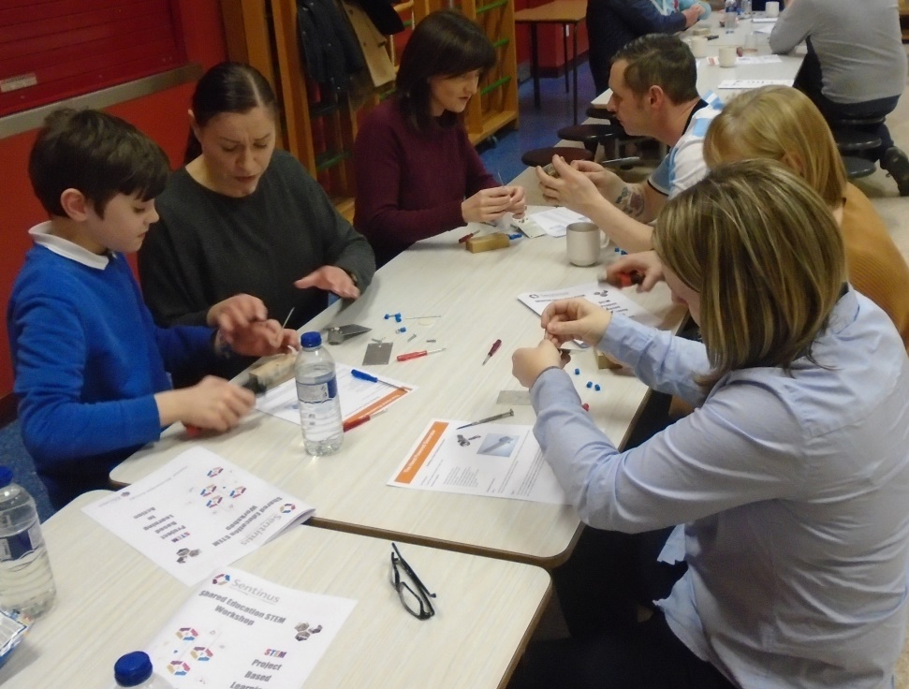
Involving everyone! Pupils – Staff - Parents

Slide 6
Meet & Greet @ Parkanaur 11.1.19

Slide 7
Hoop Races

Slide 11
Nightline communication

Slide 15
Building bridges

Slide 20
Ping pong ball manoeuvres!

Slide 25
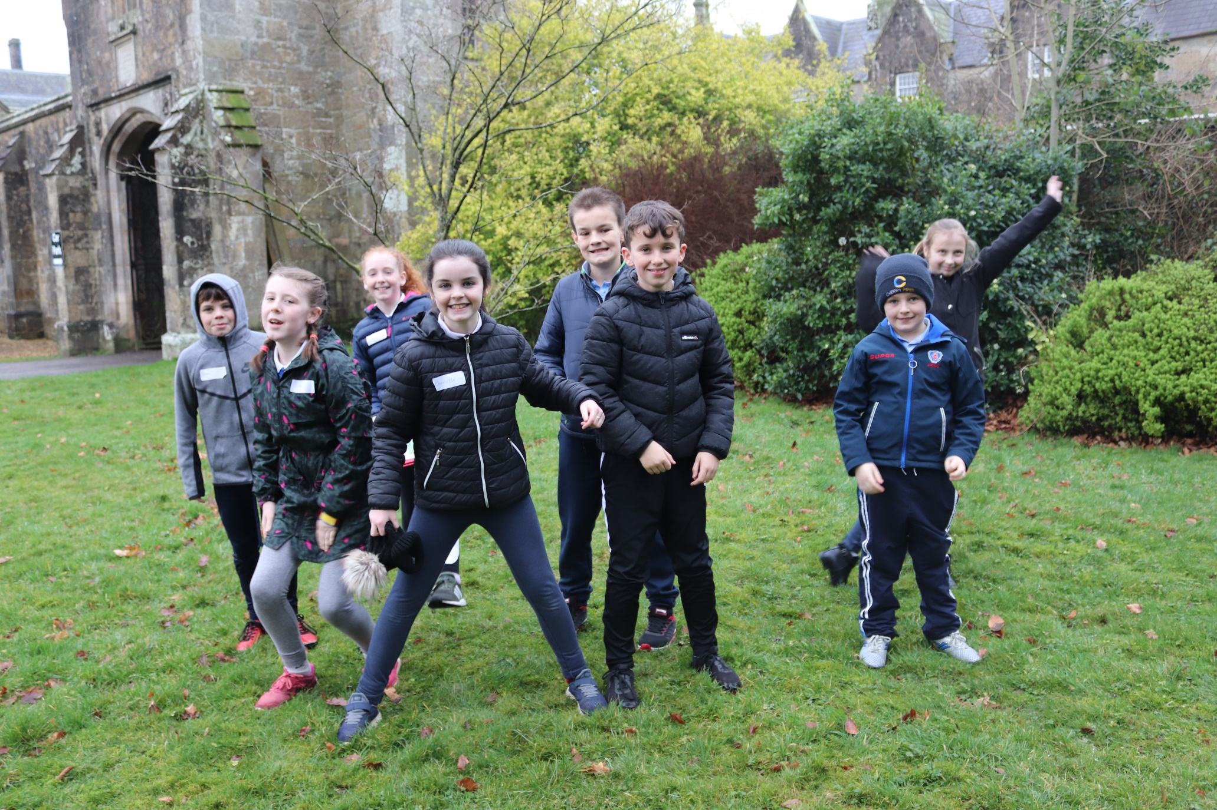
Orienteering fun!

Slide 27
Off we go!

Slide 30
Any more?

Slide 31
Flight Workshop @ DPS 18.1.19
Designing paper aeroplanes

Slide 32
Designing & Constructing Rockets

Slide 33
Which fin design will work best?

Slide 34
Ready for testing!

Slide 35
Countdown to launch!

Slide 36
Now its rocket-powered cars!

Slide 37
How will they perform?

Slide 38
Machines Workshop @ KPS 1.2.19

Slide 39
How will we attach the wheels?

Slide 40
Where should we fix the motor? How shall we tidy up all these wires?

Slide 41
Lots of decisions to be made!

Slide 42
How does it go? How could we improve it?

Slide 43
Healthy Lifestyle @ O.P.S 15.2.19

Slide 44
Measuring our reaction times!

Slide 45
Can you find your pulse?

Slide 47
How does pulse change lying down?

Slide 49
Measuring lung capacity

Slide 50
Making a set of mini lungs!

Slide 51
Floating & Sinking @ DPS 1.3.19

Slide 52
Floating oranges!

Slide 53
Can you now make your orange sink?

Slide 54
Making a boat to carry marbles!

Slide 55
This ‘Play-Doh’ is rather messy!

Slide 56
Final score: Clay 1 - ‘Play-Doh’ 0

Slide 57
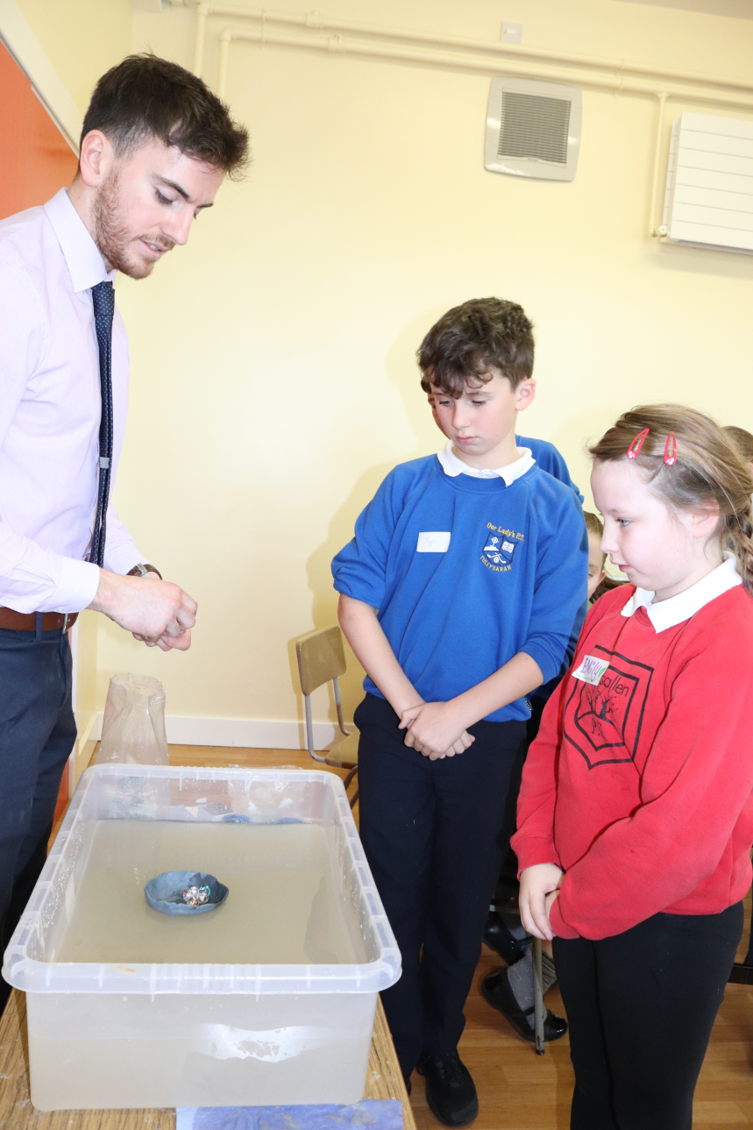
Testing time!

Slide 58
Guess whose boat held the most marbles?

Slide 59
Cartesian Diver Problem-solving

Slide 60
It all came down to ‘Blu-tack’!

Slide 61
Games & a time to reflect @ OLPS 22.3.19

Slide 64
Group reflections

Slide 66
Group Feedback

Slide 70
Pupil reflections!

Slide 71
Exploring @ W5 3.5.19

Slide 77
Augmented Reality - Walking with dinosaurs!

Slide 80
Climbit!

Slide 88
Teacher Development
Paper aeroplane fun!

Slide 89
Formula 1 racers!

Slide 90
Rocket launching!

Slide 91
Family evening fun!

Slide 93
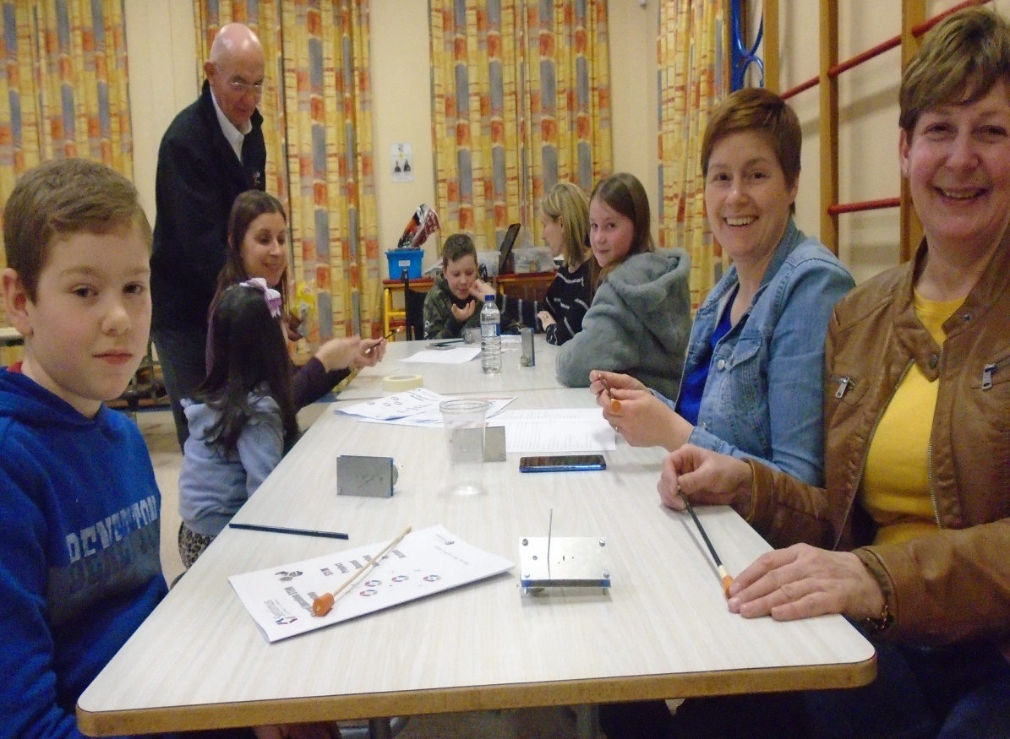

Slide 96
Lessons learnt, friends made and memories to treasure!
STEM Project 2019

